Slide 1
SHANDIA DATA COLLECTION
Illustrative examples of data generated by Shandia
2023

Slide 2
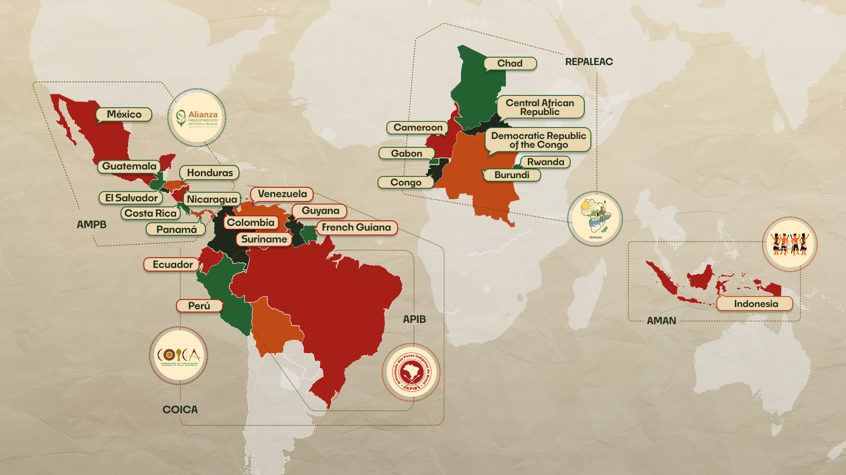
0.19%
99.81%

Slide 3
Indigenous peoples constitute
<1%
6.2%
of international climate development aid allocation supported tenure rights and forest management from 2011-2020.
Direct funding to our organisations constituted on average
36%
of the global population, but
of globally intact forests
&
18.7%
of the extreme poor
24%
7%
of above-ground carbon in tropical forests are found within our territories.
of funding under the first year of the Pledge.
Notes:
Suggest to add to last column: but only 0.19% of funding from some donors

Slide 4
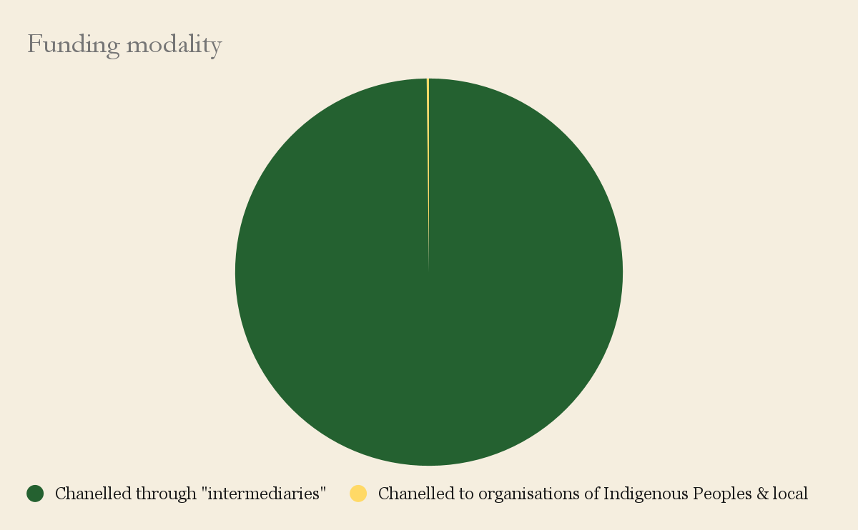
PROJECTS RELATED TO THE FOREST TENURE PLEDGE 2021-23: Example bilateral donor, total budget 580 Million USD
0.19%
99.81%

Slide 5
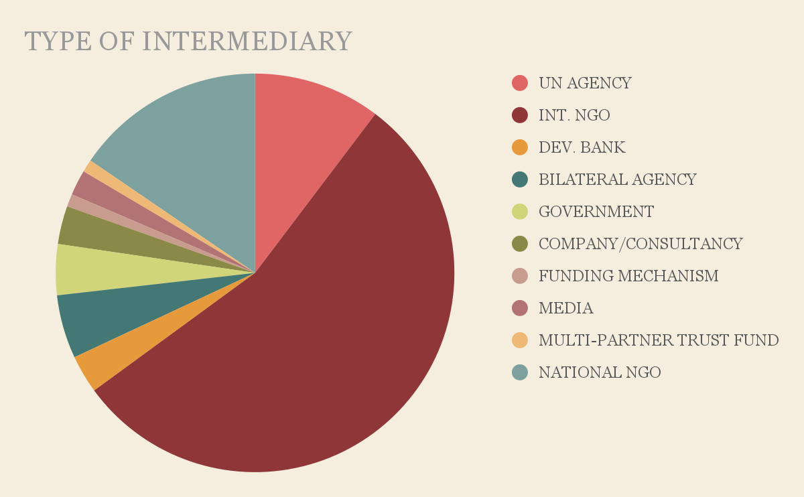
"INTERMEDIARIES” – BILATERAL DONOR

Slide 6
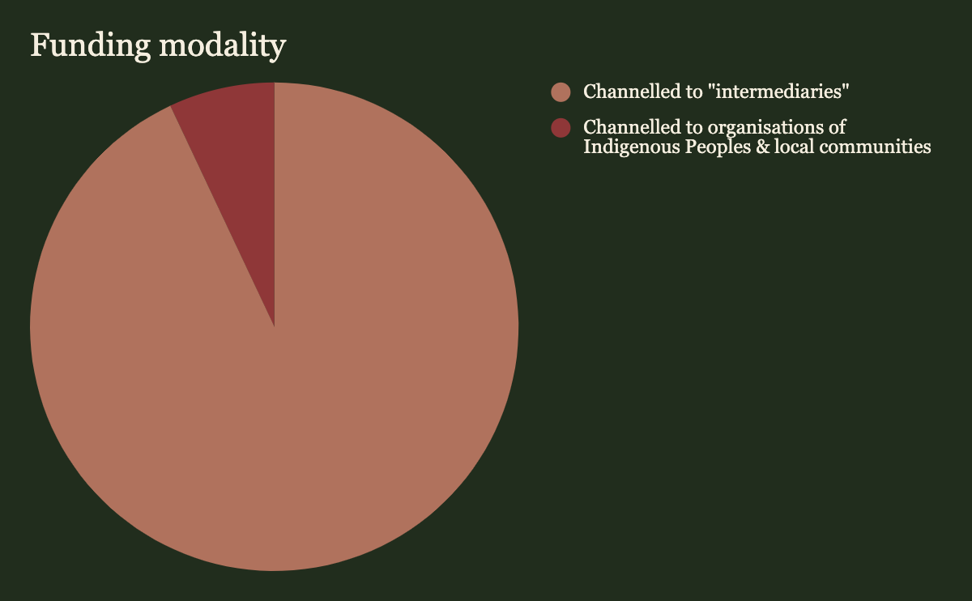
PROJECTS RELATED TO FOREST TENURE PLEDGE 2021-23 Example philanthropic funder, total budget: 75 million USD
7.0%
93.0%

Slide 7
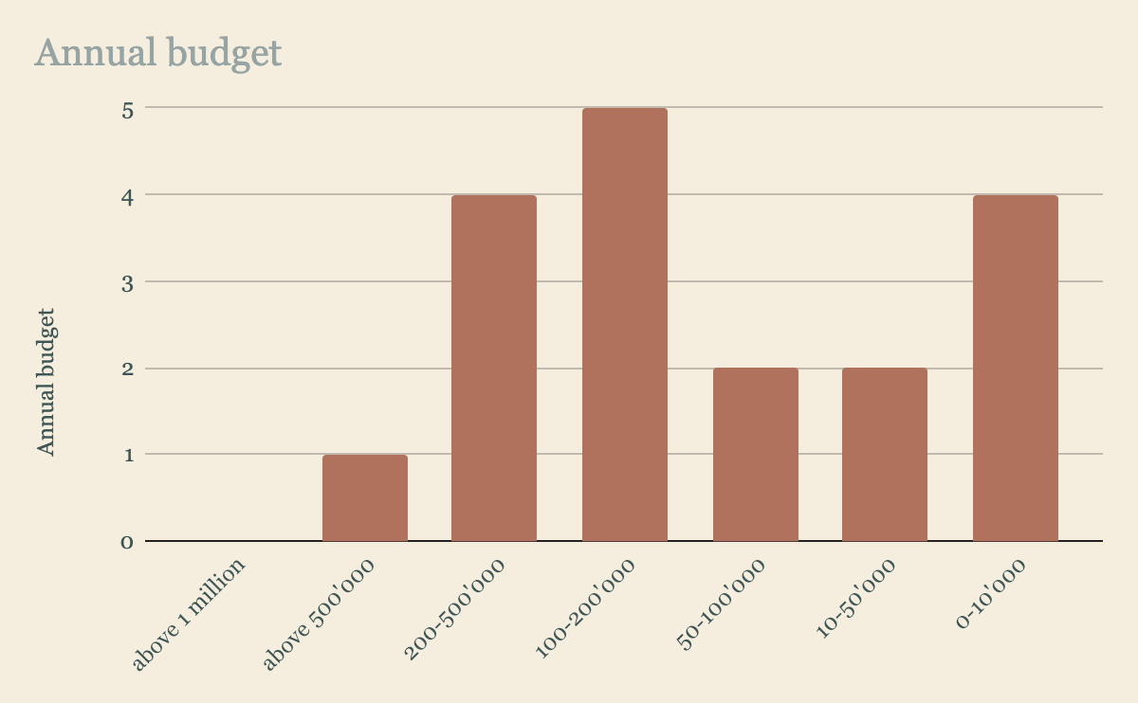
AVERAGE ANNUAL BUDGET REPALEAC MEMBERS

Slide 8
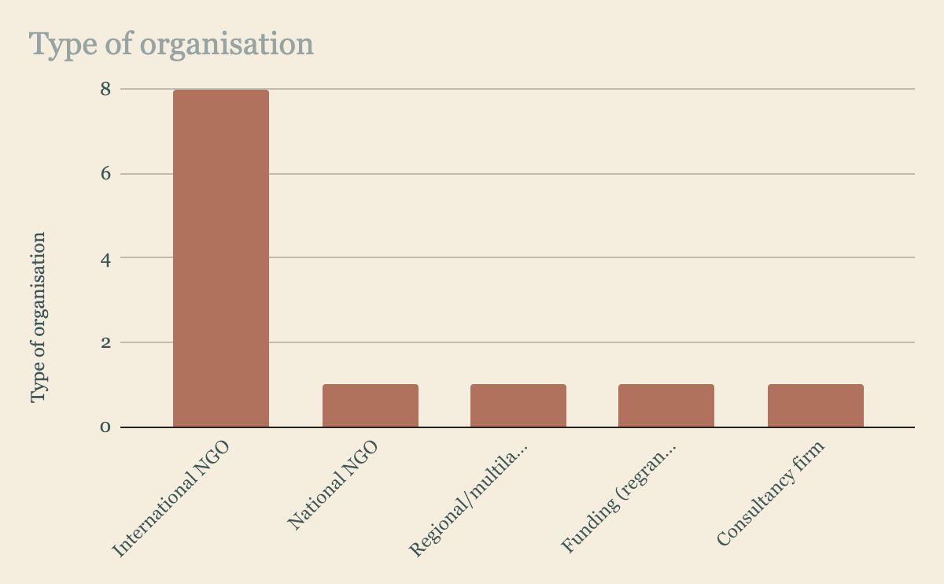
OUR GLOBAL PARTNERS AND ALLIES

Slide 9
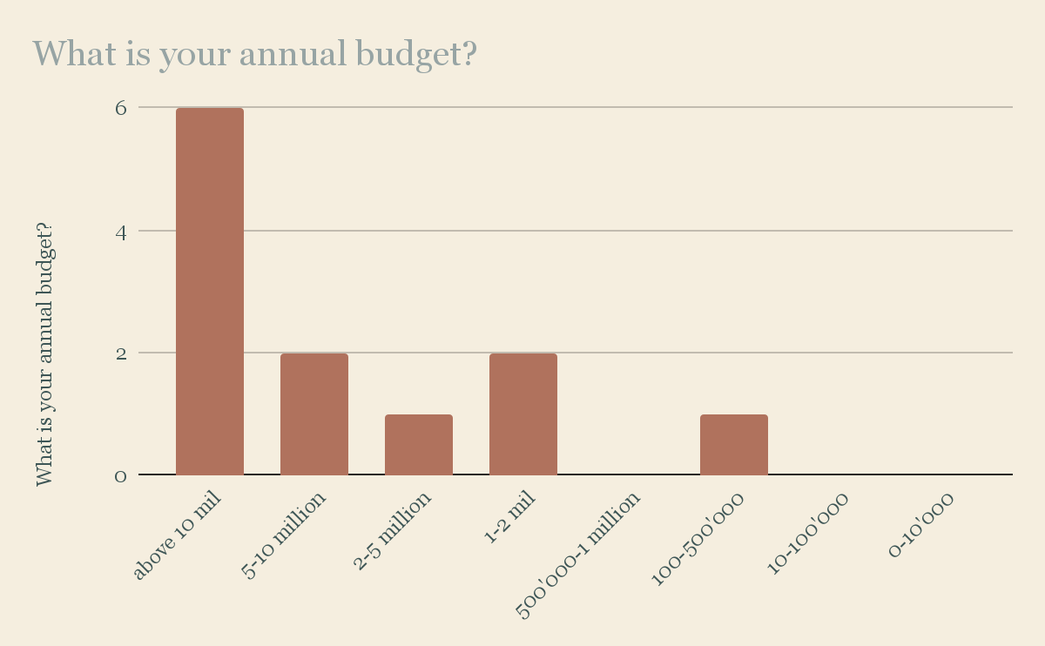
ANNUAL BUDGET

Slide 10
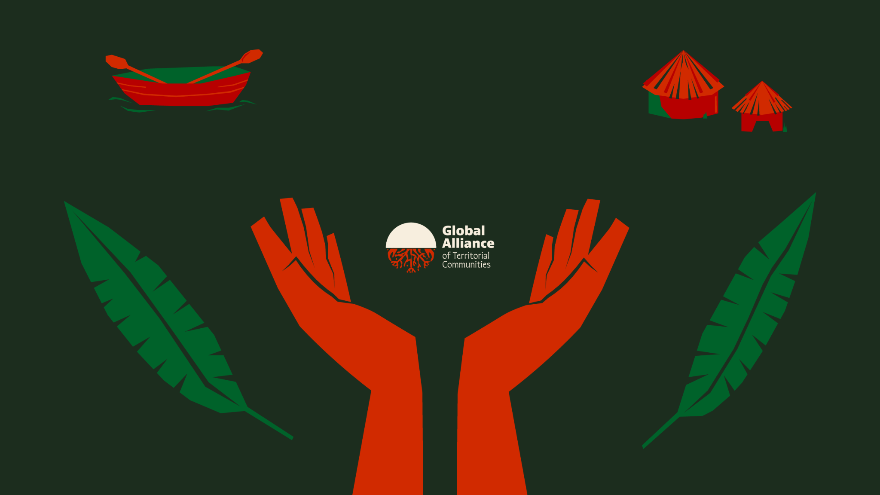
Keep updated on
www.globalalliance.me/shandia
@globalalliancet

