Slide 1
OECD-DAC: Key institutions for donor reporting
Harsh Desai
06 November 2023

Slide 2
Contents
A
Overview of DAC statistics and the DAC statistical framework
B
Concept of ODA
C
Accessing the data

Slide 3
A. Overview of DAC statistics and the DAC statistical framework

Slide 4
DAC – Main activities
Collects statistics and monitors development finance flows
Analyses, reviews and provides guidance on development co-operation policies
Conducts peer reviews
Promotes sharing of good practices
Works on development effectiveness
Promotes Policy Coherence for Development
Helps shape the global development architecture

Slide 5


Data Collection
32
DAC Members
60+
Multilateral organisations
Quality assurance on 250,000+ Aid activities / year, aggregate level data and themes
20 non-DAC providers + 46 private foundations
Online databases
Data, methodology, analysis
http://oe.cd/fsd
Who spends what, where, how and for what purpose?
DAC statistics are the only source of reliable, comparable and complete data on development assistance.

Slide 6
Bilateral Resource Flows
 | Concessional | Non-concessional
Official | Official development assistance (ODA) --grants --concessional loans --technical assistance | Other official flows (OOF) --non-concessional loans (e.g. by DFIs) --investment-related transactions Officially supported export-credits
Private | NGOs, foundations and other charitable flows | Private flows at market terms --FDI and portfolio investment --bonds

Slide 7
Multilateral Resource Flows
Multilateral agencies active in development | Concessional | Non-concessional
World Bank Group and other IFIs Regional Dev. Banks etc. | IDA grants and loans AfDF/ grants & loans etc. | IBRD loans, IFC loans and investments AfDB loans etc.

Slide 8
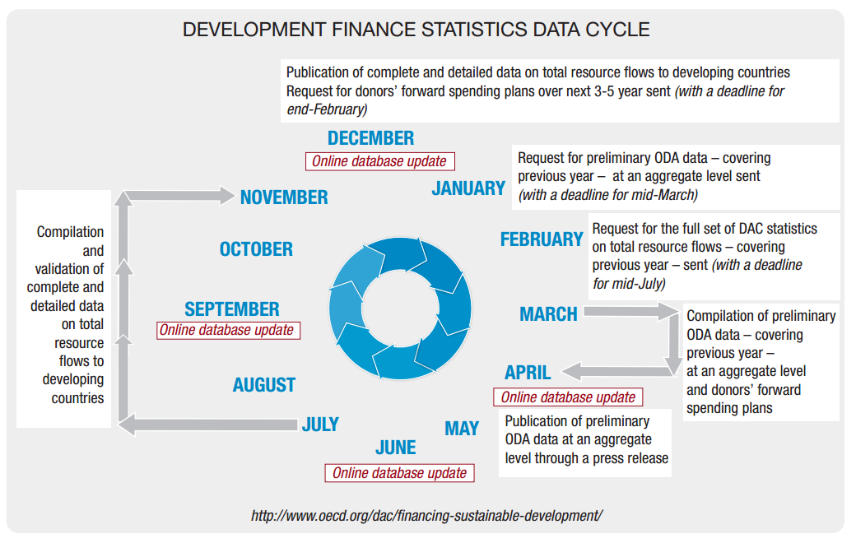
Data Cycle

Slide 9
The Global Picture of Aid
Donor
perspective
Bilateral Donors
31 DAC countries
Australia
Austria
Belgium
Canada
Czech Republic
Denmark
Estonia
Finland
France
Germany
Greece
Hungary
Iceland
Ireland
Italy
Japan
Korea
Lithuania
Luxembourg
Netherlands
New Zealand
Norway
Poland
Portugal
Slovenia
Slovak Republic
Spain
Sweden
Switzerland
United Kingdom
United States
Non-DAC providers
Kuwait
UAE…..
Recipient
perspective
Bilateral aid projects
Aid recipient
countries
Multi-bi
Projects
“earmarked”
Multilateral Institutions
UN Programmes and funds
UNDP
UNICEF
UNFPA etc.
World Bank Group
IDA
IBRD
EU Institutions (DAC member)
Regional Development Banks
African Dev. Bank
Asian Dev. Bank
Inter-Amer. Dev. Bank etc. Other agencies
IFAD
GAVI etc.
Bilateral aid received
Extra-budgetary funding
Multilateral
contributions
“core”
Multilateral
aid projects
Regular budget
Multilateral aid received

Slide 10
Collecting CRS data
Over 60+ data points for each transaction – abut 250 000 activities a year – over 50 years of data
including
CRS Purpose codes
(Sectoral Classification)
Types of aid
(e.g. budget/sector support, pooled funds, projects, scholarships etc.)
Providers
Commitments and yearly Disbursements
Channels of delivery
(first implementing partner)
Title and Description
Recipients
Face value and
risk-adjusted
grant equivalent
Financial Instrument
(e.g. grants, loans, equity etc.)
SDG targets or goals
(voluntary reporting from 2019)

Slide 11
DAC data validation process
Data on 60+ items are reported for each activity in the CRS:
E.g. Donor, recipient, type of flow, financial tool, sector, amounts, etc.
Check completeness of submission (data coverage)
Check coding for most fields: types of aid, sectors, channels of delivery, tying status (some checks are manual)
Check data coherence between various fields (example: bi-multi vs. type of aid)
Correspond with donors and obtain their validation of all proposed changes
Correct errors according to donor’s approval

Slide 12
Strengths of DAC Statistics
Global Picture – DAC data collection covers total resource flows, not just aid.
Comparability and reliability – Data are reported on the same basis by all donors. Wherever possible the statistics conform to balance-of-payments norms and definitions.
Accountability – DAC statistics are used to measure donors’ compliance with various international recommendations in the field of development co-operation (terms, volume), and monitor progress against specific policy objectives, such as, previously the MDGs and now the SDGs.
Transparency – One central data collection repository. All data are available for free online in multiple formats at www.oecd.org/dac/stats/idsonline.
Aid Coordination – The DAC is the principal OECD body discussing issues related to co-operation with developing countries. It provides a platform for dialogue and coordination between donors and agencies.

Slide 13
B. Concept of ODA

Slide 14
Concept of Official Development Assistance
  ODA Flows to the DAC List of ODA recipients (countries and multilateral development institutions)
O
  “Official”: Provided by official agencies, including state and local governments, or by their executive agencies
D
  “Developmental”: Administered with the promotion of the economic development and welfare of developing countries as its main objective
A
  “Assistance”: Concessional in character. Provided in the form of grants or soft loans.

Slide 15
What is ODA?
Humanitarian aid and long term development
Core (general) contributions for development
  General support to the recipient government budget including funding to support the implementation of macroeconomic reforms.
  Core contributions to NGOs and multilateral institutions active in development (UN agencies, Multilateral Development Banks, etc.)
Projects aiming at improving eco development & welfare of dev. countries
  Infrastructure project, e.g. construction of hospital, school, tramway, dam etc.
  Capacity building project, e.g. Ministry of justice capacity building - rule of law.
Technical assistance
  Experts, consultants, teachers, academics, researchers, interns, volunteers contributing to development.
  Training & research; language training; workshops, seminars & conferences.
Debt relief operations
Certain in-donor costs (administrative, refugees, scholarships, development awareness).

Slide 16

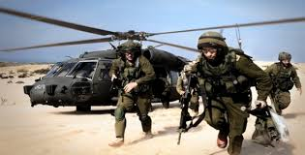

What is not ODA?
Primarily commercial objectives
Military aid and promotion of donor’s security interests
Promotion of language or culture of the provider country
Religious objectives
Not sufficient for an activity to have a positive impact on development to qualify as ODA, it needs to have development as its primary objective.

Slide 17
How to check ODA or not?
Who benefits from the activity/contribution?
Bilateral contribution
Multilateral (core) contribution
possibly channelled through a multi org. on Annex 2 or not
A country on the DAC List
A country not on the DAC List
A multilateral organisation on “Annex 2”
A multilateral organisation not on “Annex 2”
Does the activity have a primary development purpose?
YES
NO
YES
Is the financing concessional?
NO
NO
YES
NO
Eligible
as ODA
Not eligible
as ODA
Not eligible
as ODA
Not eligible
as ODA
Eligible
as ODA
Not eligible
as ODA

Slide 18


DAC statistical standards
  CRS Purpose codes (sectors)
  Channels of delivery
  Financial instruments
  Types of aid
  Policy markers

Slide 19
Example of the CRS purpose codes (sectors)
DAC 5 CODE | CRS CODE | DESCRIPTION | Clarifications / Additional notes on coverage
110 |  | EDUCATION
111 |  | Education, level unspecified | The codes in this category are to be used only when level of education is unspecified or unknown (e.g. training of primary school teachers should be coded under 11220).
 | 11110 | Education policy and administrative management | Education sector policy, planning and programmes; aid to education ministries, administration and management systems; institution capacity building and advice; school management and governance; curriculum and materials development; unspecified education activities.
 | 11120 | Education facilities and training | Educational buildings, equipment, materials; subsidiary services to education (boarding facilities, staff housing); language training; colloquia, seminars, lectures, etc.
 | 11130 | Teacher training | Teacher education (where the level of education is unspecified); in-service and pre-service training; materials development.
 | 11182 | Educational research | Research and studies on education effectiveness, relevance and quality; systematic evaluation and monitoring.
112 |  | Basic education
 | 11220 | Primary education | Formal and non-formal primary education for children; all elementary and first cycle systematic instruction; provision of learning materials.
 | 11230 | Basic life skills for youth and adults | Formal and non-formal education for basic life skills for young people and adults (adult education); literacy and numeracy training.
 | 11240 | Early childhood education | Formal and non-formal pre-school education.
113 |  | Secondary education
 | 11320 | Secondary education | Second cycle systematic instruction at both junior and senior levels.
 | 11330 | Vocational training | Elementary vocational training and secondary level technical education; on-the job training; apprenticeships; including informal vocational training.
114 |  | Post-secondary education
 | 11420 | Higher education | Degree and diploma programmes at universities, colleges and polytechnics; scholarships.
 | 11430 | Advanced technical and managerial training | Professional-level vocational training programmes and in-service training.

Slide 20
Selecting the right purpose code
Selecting a sector. Key question “which specific area of the recipient’s economic or social structure is the transfer intended to foster”.
Some contributions are not susceptible to allocation by sector and are reported as non-sector allocable aid. E.g. general budget support.
Some examples:
Construction of housing for experts working on an agricultural development project:
The appropriate code is “agricultural development” (31120) and not “housing policy and administrative management” (16030).
Sector specific education activities are to be included in the respective sectors, either in a specific education code or in a general code. For example:
Upgrading of an agricultural training centre. The appropriate code is “agricultural education” (31181).

Slide 21
Channels of delivery

Slide 22
40000 – MULTILATERAL ORGANISATIONS
41000 | UNITED NATIONS AGENCY, FUND OR COMMISSION (UN)
41301 | Food and Agricultural Organisation
41130 | United Nations Relief and Works Agency for Palestine Refugees in the Near East
42000 | EUROPEAN UNION INSTITUTION (EU)
42001 | European Commission - Development Share of Budget
43000 | INTERNATIONAL MONETARY FUND (IMF)
43005 | International Monetary Fund - Post-Catastrophe Debt Relief Trust
44000 | WORLD BANK GROUP (WB)
44001 | International Bank for Reconstruction and Development
44002 | International Development Association
45000 | WORLD TRADE ORGANISATION
45002 | World Trade Organisation - Advisory Centre on WTO Law
45001 | World Trade Organisation - International Trade Centre
46000 | REGIONAL DEVELOPMENT BANK
46003 | African Development Fund
46025 | Islamic Development Bank
47000 | OTHER MULTILATERAL INSTITUTION
47111 | Adaptation Fund
47009 | African and Malagasy Council for Higher Education

Slide 23
C. Accessing the data

Slide 24
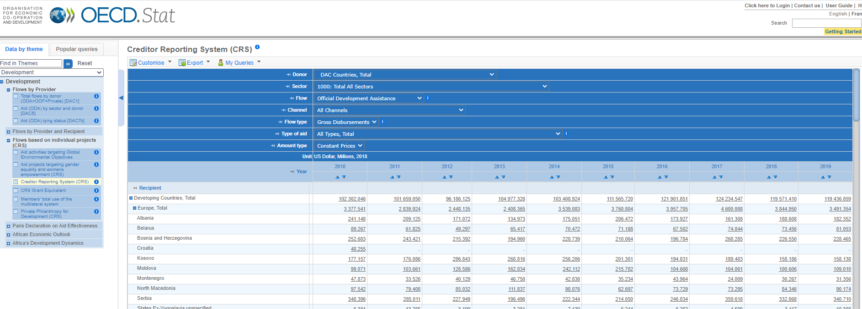
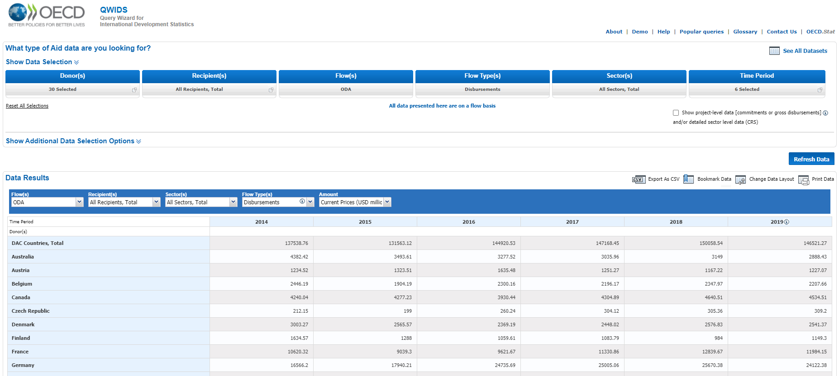
Online databases
https://stats.oecd.org/ then select “Development”
https://stats.oecd.org/qwids/

Slide 25
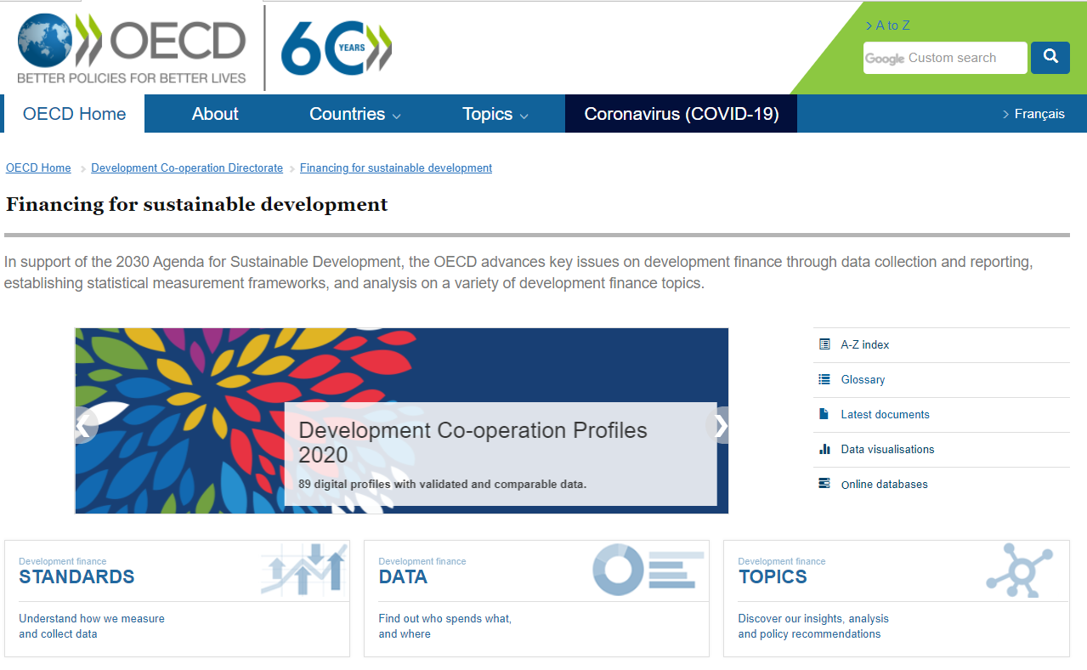
Web – standards, data, topics http://www.oecd.org/dac/stats/

Slide 26
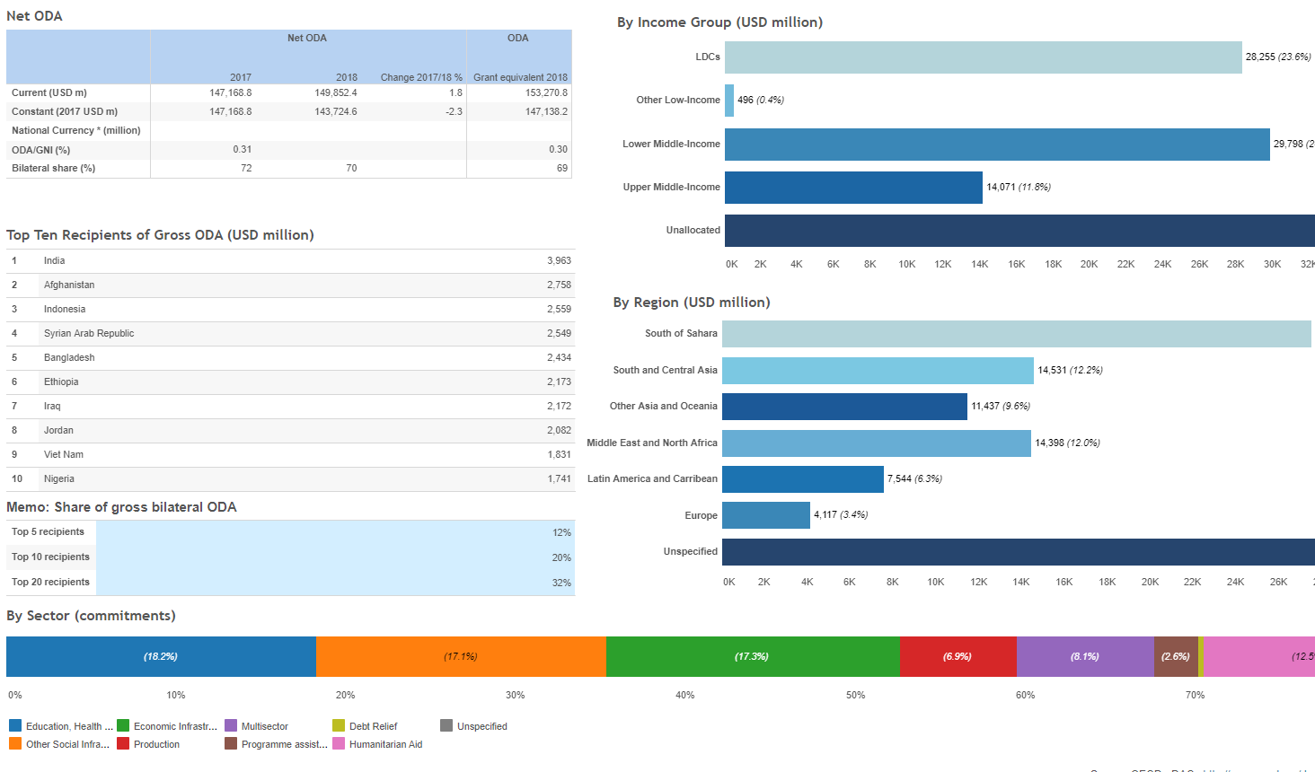
Aid at a Glance by Donor / Recipient

Slide 27
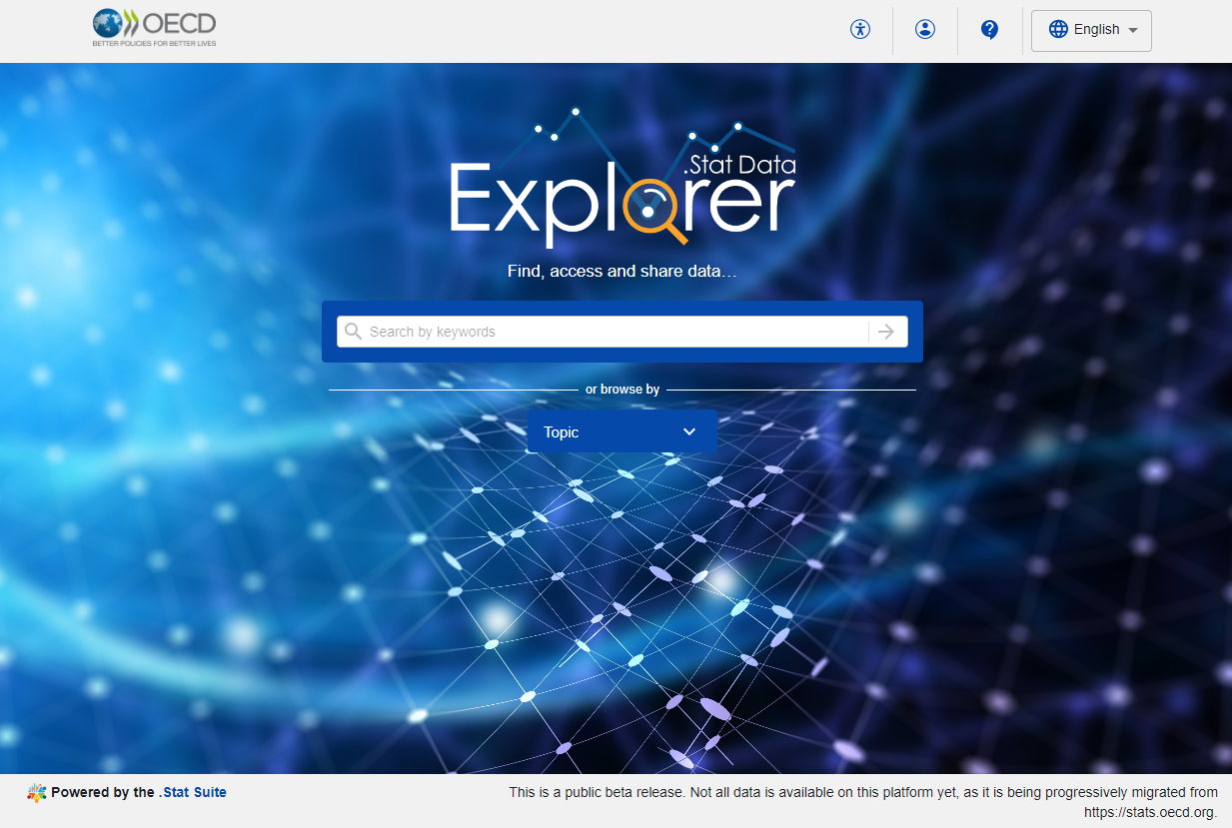
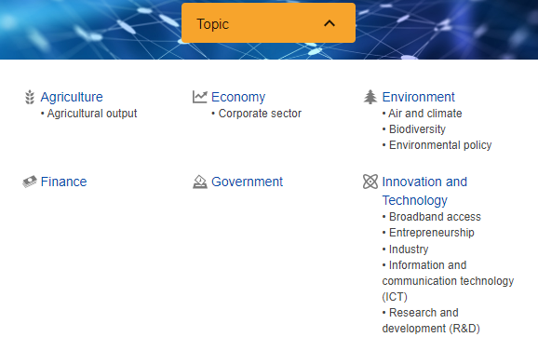
.Stat Suite Data Explorer
data-explorer.oecd.org
Notes:
Use the Search/Keywords or click on a main ‘topic’ (e.g. Agriculture or Environment) or topic dataset (dataflow) (e.g. Air and climate)

Slide 28
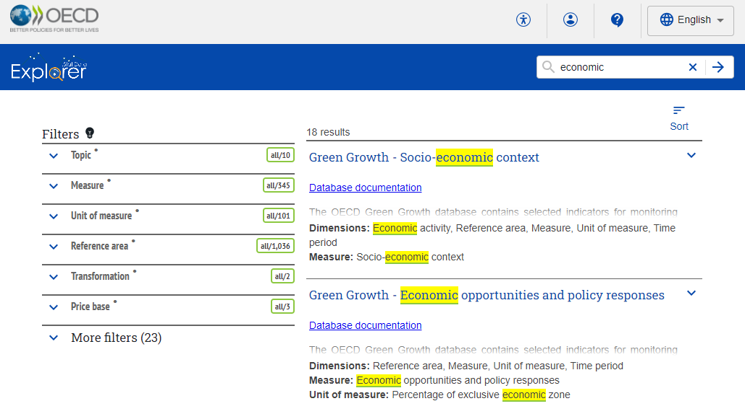
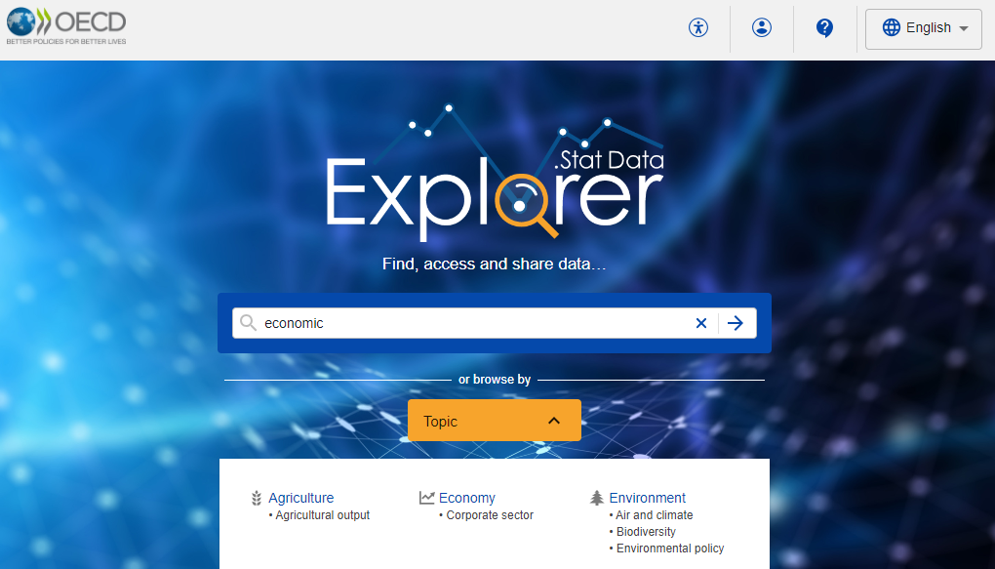
Search and easily find (avoids “0 results”)
faceted search = augmenting traditional text search with a faceted navigation system
Notes:
Searching in data-explorer will return results of the search term, whether that is the name of a dataset (dataflow in SDMX terminology) or elsewhere..
The faceted search combines search and navigation.

Slide 29
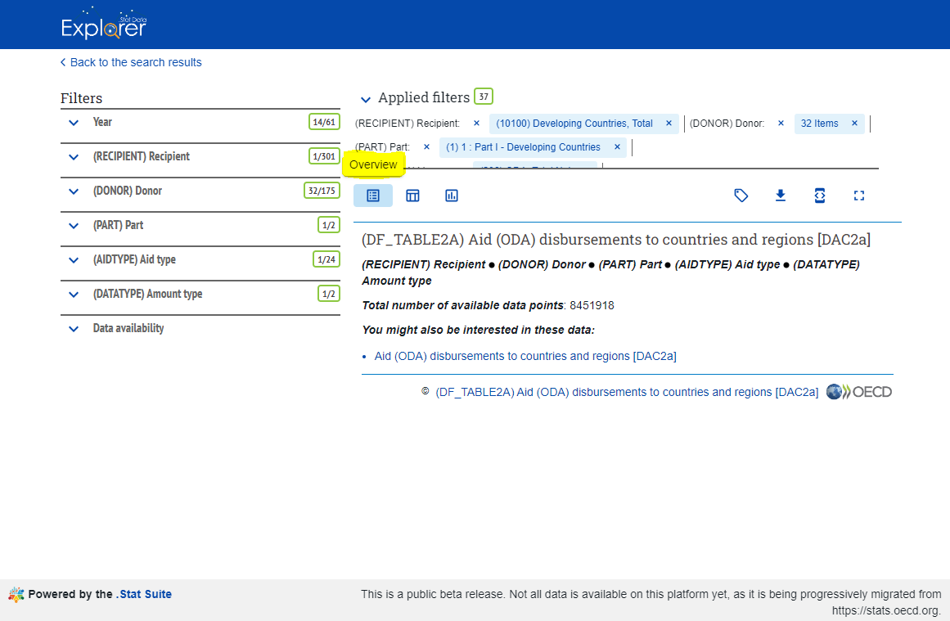
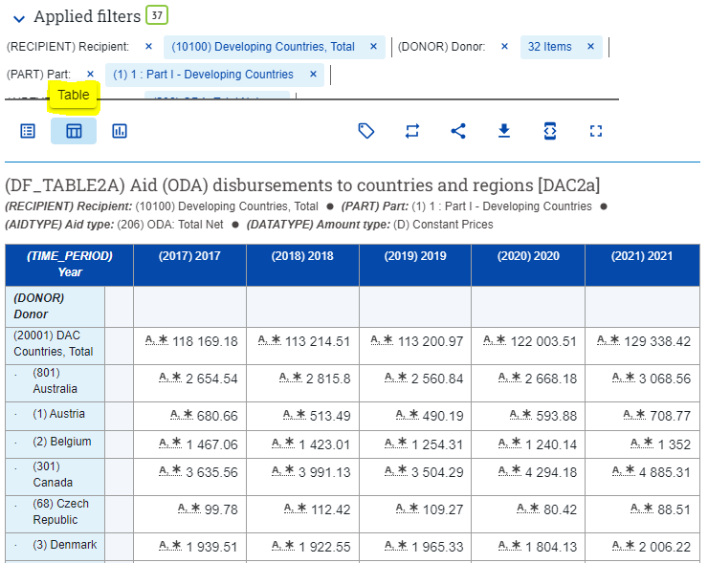
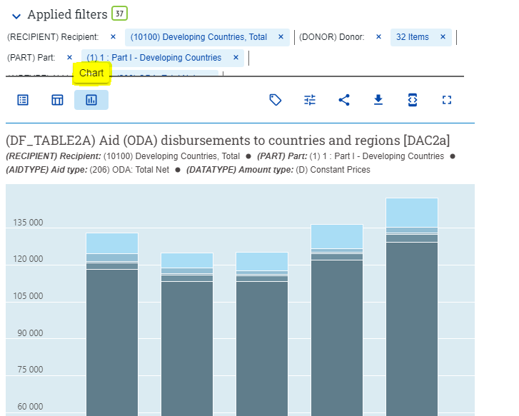


Options for each ‘dataflow’
When opening a dataflow, by default, the Overview will be displayed.
Click on Table to view the data.
Charts are also possible.
Other options when viewing data are
Layout and Download.

