Slide 1
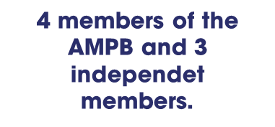
tracking, monitoring and aligning with local priorities
FTM Board of Directors
Monitoring system: rporting and platform in place ( clear impact and results indicators)
Heavy pre-investment activities (technical/ financial assitance and support during the formulation , implementation and closure )
Consultation processes at territorial level ( leadership) to define priorities and alignment with political agenda /donnors. .
Development of capacities and tracking of direct investment and matching funds.
Development of grievance mechanism system /Social and Environment safeguards

