Slide 2
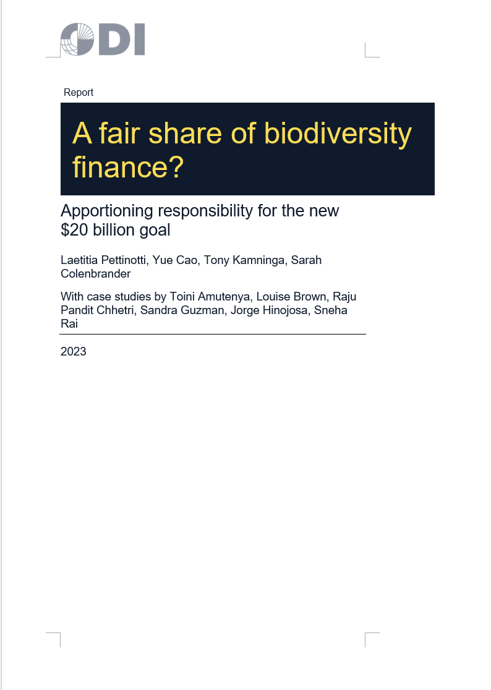
Tracking funds for the indispensable partners
Session 4: How far can we get with existing donor reporting?
Yue Cao
Research Associate, ODI

Slide 3
Estimating biodiversity related development finance using OECD CRS data (2021)
OECD CRS 2021
Biodiversity Rio Markers
Biodiversity SDG Markers
Biodiversity purpose codes
Started with OECD methodology, in Biodiversity and Development Finance - Main Trends, 2011-20
Data triangulation
Systematic search for biodiversity-related keywords within the project titles and descriptions in our dataset
Manual checks on 75% of the reported finance value in our dataset to ensure accuracy of reported biodiversity information. (Searched for reported programmes and activities’ publicly available information)

Slide 4
Issue 1: inconsistent reporting of biodiversity information
Notes:
Inconsistent reporting of biodiversity Rio markers across bilateral providers
Reporting on the Rio markers is mandatory for ODA from DAC members, but voluntary for others (i.e. multilaterals)
Inconsistent reporting of biodiversity activities among multilateral institutions – there is an opportunity here to require better reporting on the part of multilateral institutions

Slide 5
Issue 2: Overestimation of aid activities contributing to biodiversity objectives
Notes:
15% of bilateral Rio Markers corresponds to more than USD 800 million of aid activities that do not target biodiversity objectives but are reported as such

