Slide 1
Tracking Funds for the Indispensable Partners
Paris, November 6-7, 2023

Slide 2
International Funders for Indigenous Peoples
IFIP is the only philanthropy network dedicated to Indigenous Peoples worldwide
IFIP is a global community of 54 members: private, family, public foundations and Indigenous Led Funds
Vision
Indigenous Peoples, their communities, lands and territories worldwide are flourishing, recognized, self-determined, equitably funded and resourced
Mission
IFIP is dedicated to shifting power, mobilizing resources, and building partnerships to amplify Indigenous leadership and to support Indigenous Peoples’ self-determination and rights.
Strategic Goals
- Address the asymmetry of power in philanthropy
- Advocate for direct access to equitable funding and mobilize resources to IPOs across issues and movements.
- Build relationships and improve and expand funding partnerships
Our Why
Unique role
Goals
Our values
Pathways

Slide 3
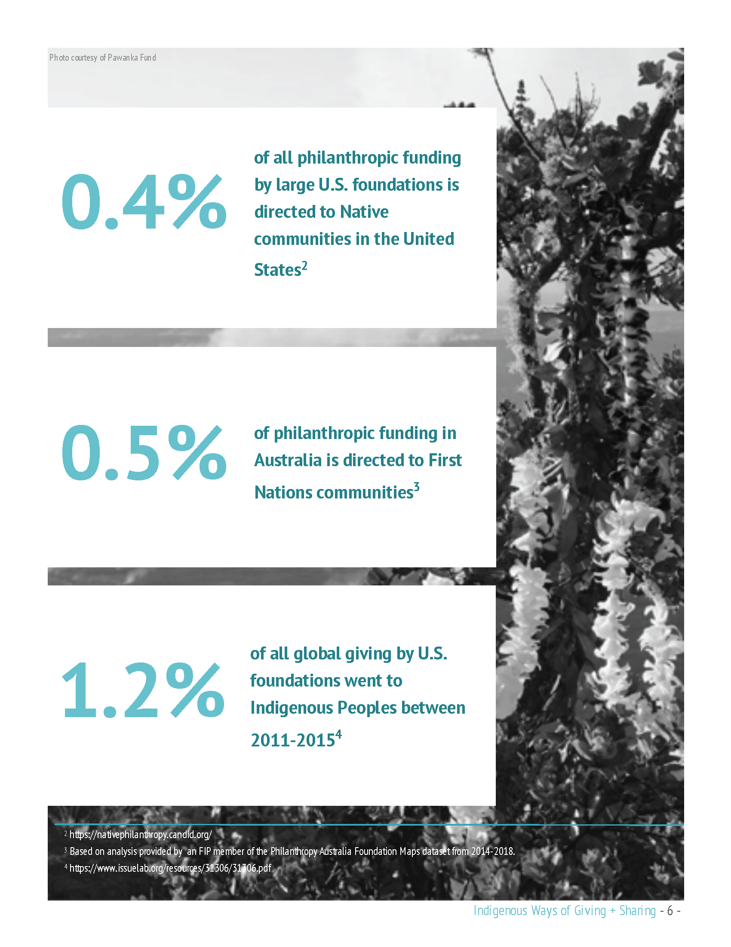
IFIP published the first body of work in philanthropy focused on Indigenous Led Funds
Philanthropy Funding Data
2016-2019 COF Global Giving by U.S. foundations

Slide 4
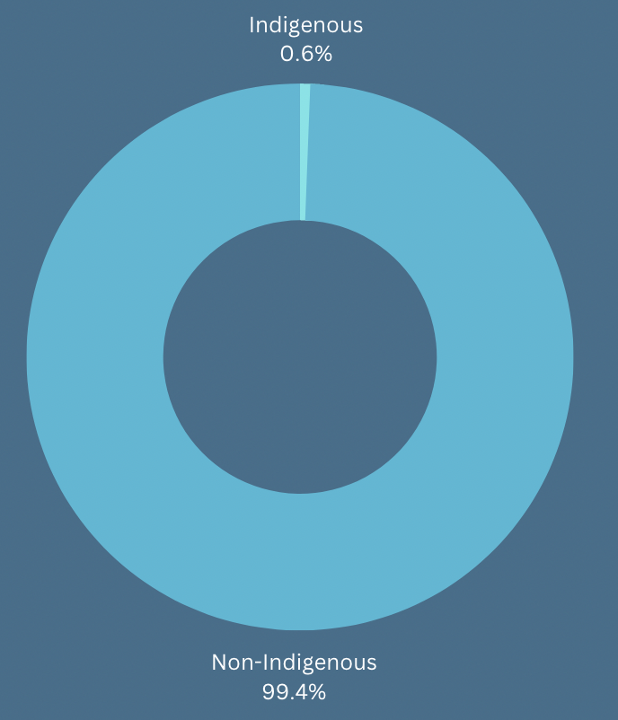
CANDID data: 2016-2019 grants of 10k and above identified as “benefiting Indigenous Peoples”
O.6% identified using keyword search and “population served” Indigenous Peoples, which is inclusive of:
Alaskan Natives, American Indians/Native Americans
Australian Aboriginal and Torres Strait Islander people,
First Nations, Inuit, Metis of Canada,
Native Hawaiians and Pacific Islanders.
Most of the funding is concentrated in a few countries and subject areas.
Consistent patterns of systemic inequity.
Unlike other reports IFIP’s analysis focuses on how much of the 0.6% directly funded Indigenous Peoples organizations across geographies, issues, and movements.
Data from Candid

Slide 5
Data Challenges
IFIP’s role and actions
Use of algorithms without data quality control translates into dozens of misclassified grants. (i.e. native plants, native animals etc)
Funders use of terms such as “BIPOC” and “POC” on grants descriptions makes it impossible to determine how much funding actually reached IPs.
Lack of disaggregated data including by different sub group and themes, limits deeper analysis.
Taxonomy should include codes relevant to Indigenous Peoples issues and priorities.
We are reviewing about 35,000 grants for data quality, verification, classification. In the process of reviewing 2020 grants dataset.
Developed a criteria to review and code grants in the following way:
Indigenous/Tribal Governments and Tribal colleges.
Indigenous organizations including Indigenous Led Funds, networks etc.
Non-Indigenous organizations.
Raised data quality concerns to Candid’s CEO and staff i.e. algorithm, duplications, inconsistencies, taxonomy etc.
IFIP will enter into a quality partnership agreement with Candid as a key partner to monitor Indigenous philanthropy data.

Slide 6
How far can we get with existing donor reporting?
Research led and managed by Indigenous philanthropy networks to influence, monitor, and track funding is crucial and require significant investment to fund research, advocacy, and narrative change.
Closer collaboration between donors and the Indigenous philanthropy ecosystem networks is essential to shift how data is counted and coded by donors to improve reporting.
Partnerships with data repositories such as IFIP and Candid partnership for data quality is one way forward.
Initiatives like Shandia, the Indigenous Led Funds Global Alliance (launched at IFIP), and other Indigenous initiatives contribute to understanding the level of funding reaching Indigenous communities. And offer a timely opportunity for the donor community to support.

Slide 7
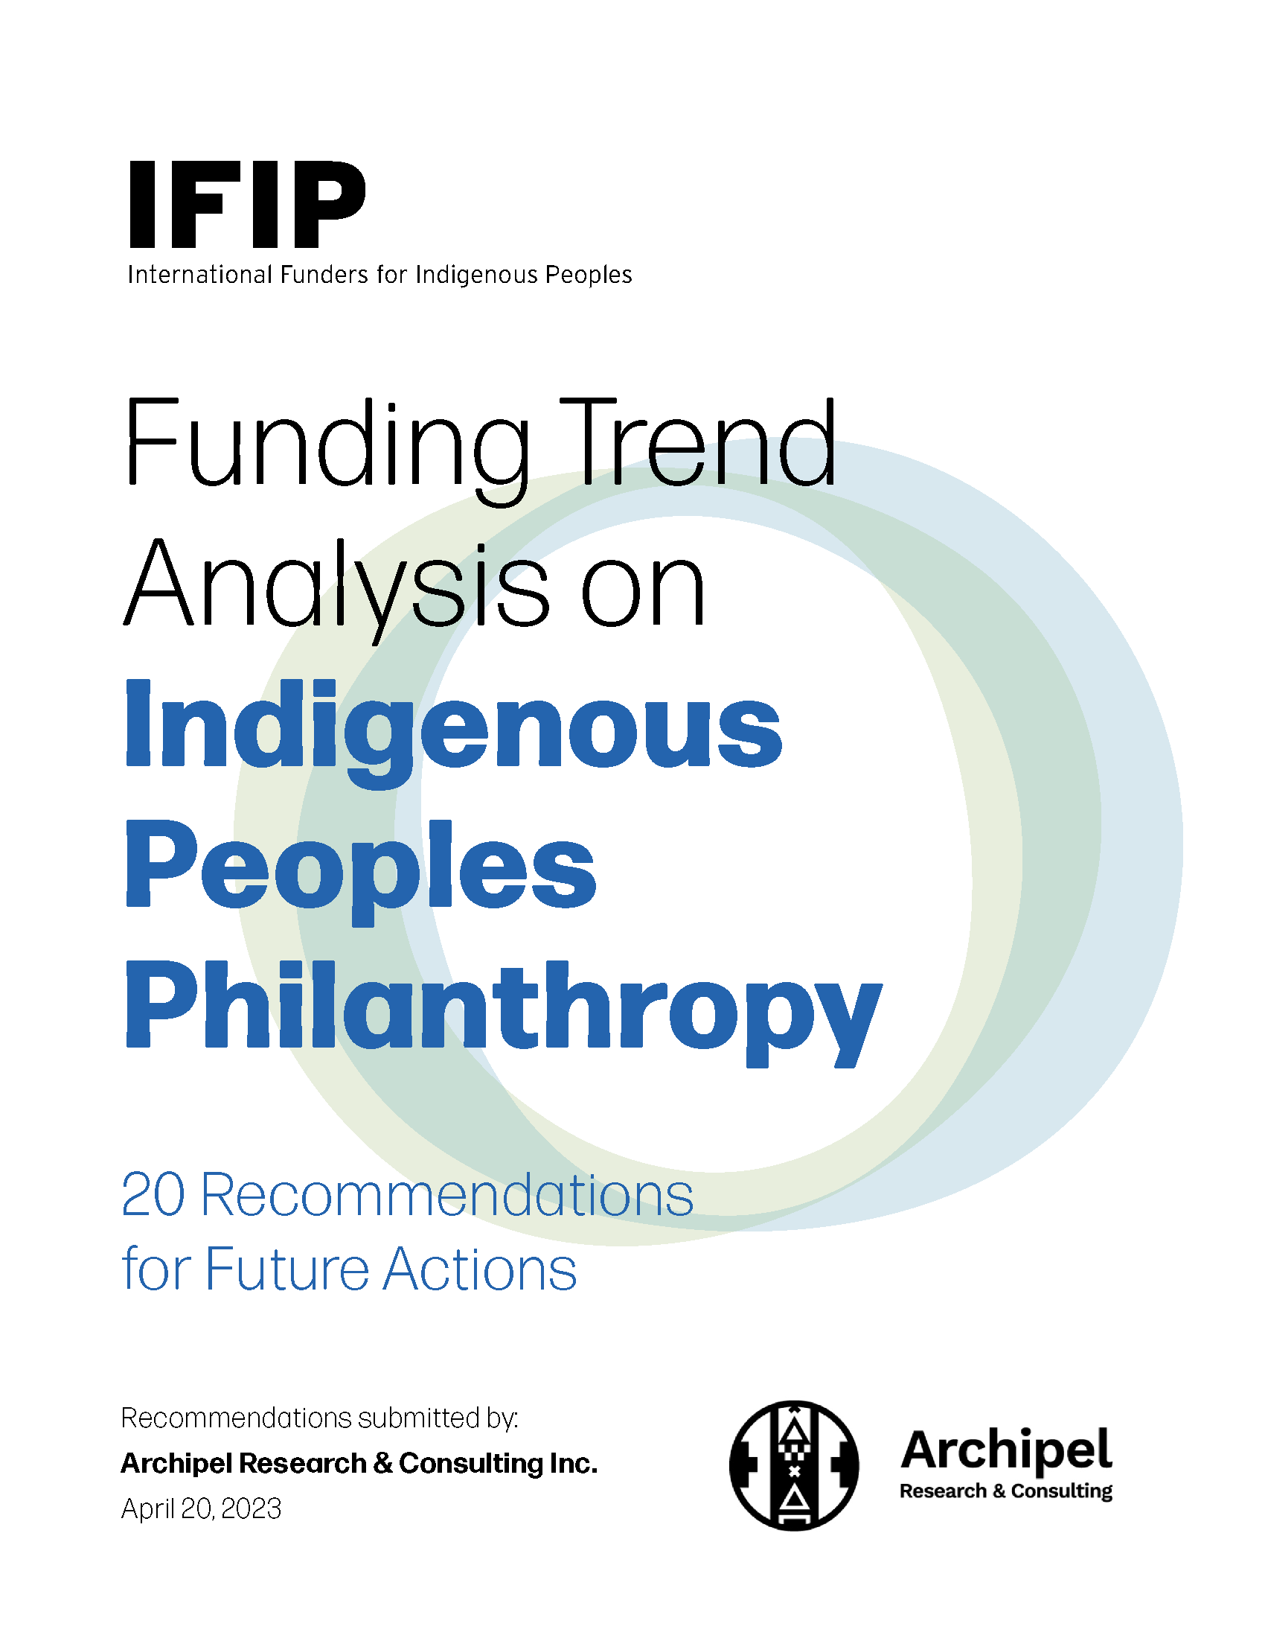
20 Recommendations for Action
A tool for funders committed to addressing asymmetry of power in philanthropy, and address barriers to funding Indigenous Peoples.
Full Funding Analysis Report to be released in early 2024

Slide 8
Thank you

Slide 9
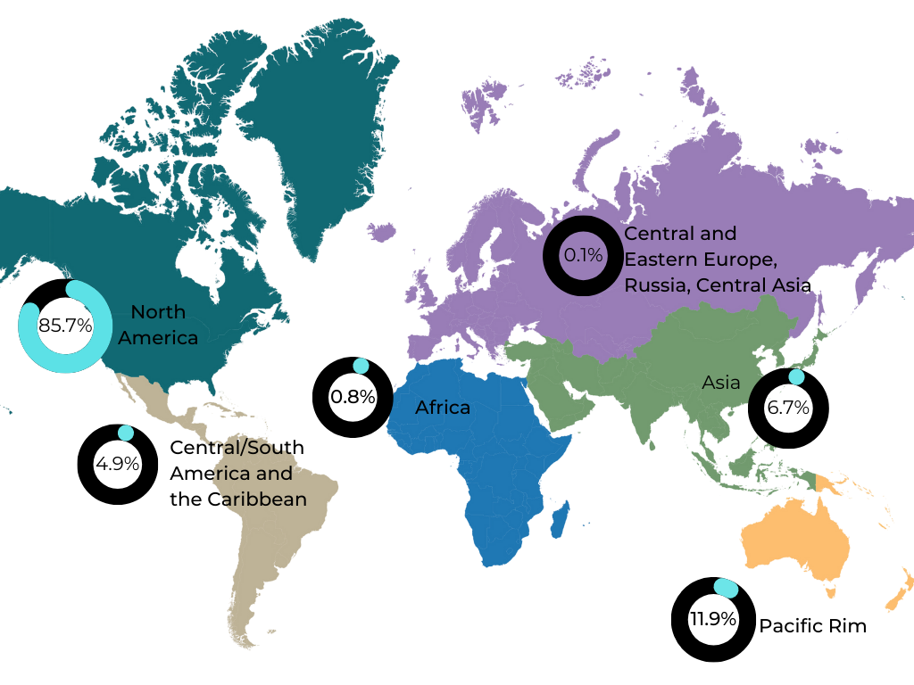
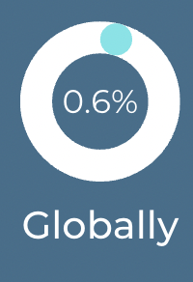
Regional Distribution of Funding from 2016 to 2019

