Slide 1
USING IATI DATA TO TRACK FUNDING
Jack Lord
Open Data Services
6-7 Nov 2023, Paris
Notes:
NOTE TO PRESENTER
Please enter the details of your event on this presentation slide.

Slide 2
01
WHAT IS IATI?
IATI Speakers' Kit: 01 INTRODUCTION
Notes:
Presentation 02 Introduction – this presentation provides a basic overview of the process of preparing and publishing IATI data

Slide 3
WHAT IS IATI?
SECRETARIAT
A global initiative to improve the transparency of development and humanitarian resources and their results to address poverty and crises
Est. 2008
IATI Speakers' Kit: 01 INTRODUCTION
Notes:
What is the International Aid Transparency Initiative?
IATI is a global initiative working to improve the transparency of development and humanitarian resources that address poverty and crises. Set up in 2008, IATI is run by a Secretariat led by the UN Development Programme (UNDP), together with staff from the UN Office for Project Services (UNOPS). Technology services are provided by Open Data Services and managed through a contract with UNDP.
IATI is funded and governed by its members representing governments, civil society and development and humanitarian organisations across the world.
NOTE TO PRESENTER
For more information on IATI’s governance and members, see Presentation 05 Governance and IATI story so far (Slides 85–94).

Slide 4
WHAT DOES IATI DO?
MANY ORGANISATIONS addressing international poverty and crises
OPEN DATA
DATA ON FUNDING AND PROJECTS
STANDARD
Open, accessible data on humanitarian and development activities
IATI Speakers' Kit: 01 INTRODUCTION
Notes:
What does IATI do?
IATI works to get all organisations involved in addressing international poverty and crises to publish open data about their spending and projects. There are many organisations, ranging from donor governments to UN agencies to small NGOs operating on the ground.
IATI encourages these organisations to publish their data according to the IATI Standard. The IATI Standard is a set of rules and guidance for publishing useful development and humanitarian data. Once IATI data is published, it is free and open for anyone to access online.
IATI then works to ensure this data is used to make the global response to poverty and crises more effective. IATI aims to support people working in the international development and humanitarian sectors to access IATI data to make better decisions about the use of resources. This data is also accessible to people holding decision-makers to account. They include journalists, civil society organisations and researchers.

Slide 5
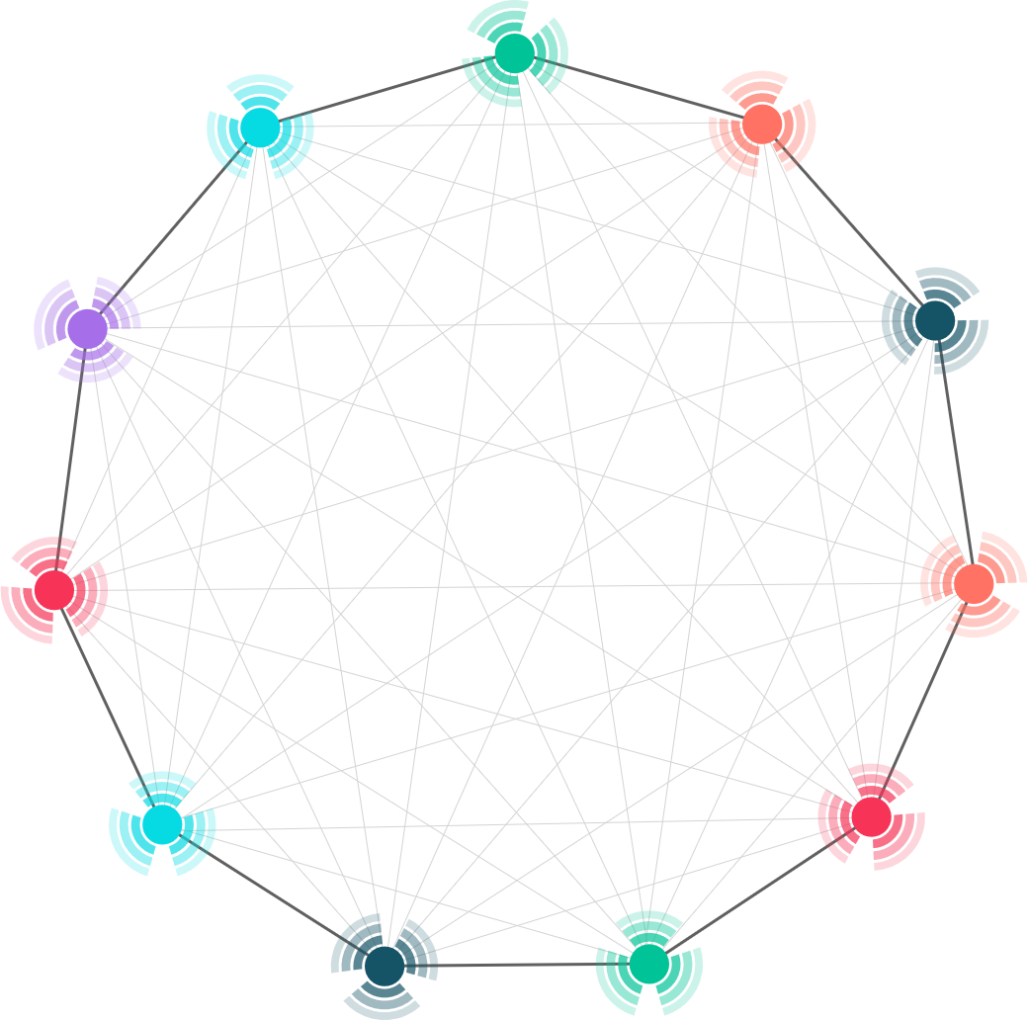
IATI AIMS TO MEET THE DEMAND FOR BETTER DATA
Up-to-date information
Data on future spending
Data in one place
Data in the same format (easy to compare)
Data on a range of resources
Data beyond finances
IATI Speakers' Kit: 01 INTRODUCTION
Notes:
Together, IATI publishers help to meet the demand for better development and humanitarian data. There are many advantages of accessing IATI data.
Users can gain:
Up-to-date information, as publishers are encouraged to refresh their data regularly. In fact all IATI data should be updated at least quarterly, and a growing number of publishers refresh their data monthly. IATI also allows for data to be updated daily, which can be especially useful in a humanitarian emergency.
Data is in one place. Users can find data from over 1000 organisations from IATI. This saves enormous time gathering data from each individual organisation, which can involve looking through many websites, reports or sending requests for information.
Users can find data on a wide range of resources. There are many types of resources that address poverty and crises. IATI includes data about a wide range of resources flowing into developing countries, from foreign aid to private investments, to south-south co-operation and climate finance.
Users can find future spending plans, not just past spending. An increasing number of IATI publishers are sharing their spending plans up to 3 years in advance. This data allows governments and other data users to better plan and coordinate future funding and services.
Users can compare data from different organisations. Every organisation has its own way to capture information, from annual reports to excel spreadsheets and internal databases. Previously, this data was difficult to compare. Now users can access data from many organisations in one format set by the IATI Standard, so it is much easier to compare and analyse.
And finally users can find data beyond finances. In addition to finances, organisations publish other useful information on their development and humanitarian activities. This includes locations, strategic documents and results.

Slide 6
HOW DOES THE INITIATIVE WORK?
CONTACT
Provide online tools and helpdesk
info@iatistandard.org
Outreach to support use of data
jack.lord@opendataservices.coop
Engage global development humanitarian bodies forums
Foster community of external technical providers
IATI Speakers' Kit: 01 INTRODUCTION
Notes:
How does the initiative work?
IATI works to support organisations to publish and use IATI data. Here is a summary of their work:
Firstly, they manage the IATI Standard. IATI’s core work has involved creating, and now maintaining the IATI Standard. This includes providing information on the rules and guidance of the IATI Standard and managing its changes and upgrades.
IATI provides online tools and a helpdesk to support organisations publish, improve and use data.
IATI delivers outreach activities such as training workshops to support developing country governments and other stakeholders to use IATI data in their work.
IATI engages with global development and humanitarian communities to increase the commitment to transparency across the world. For example, IATI engaged with the UN World Humanitarian Forum in 2016. At the event, many governments and organisations committed to publish data on their spending using the IATI Standard within 2 years.
And, IATI fosters its community of external technical experts and providers. This community provides additional IATI products and services to help hundreds of organisations publish and use IATI data.

Slide 7
02
WHAT CAN IATI TELL US?
IATI Speakers' Kit: 01 INTRODUCTION
Notes:
Presentation 02 Introduction – this presentation provides a basic overview of the process of preparing and publishing IATI data

Slide 8
MAJOR TRANSPARENCY PROGRESS...
2008
2011
2013
2016
2019
IATI is launched at the Third High Level Forum on Aid Effectiveness in Accra
International development community endorses IATI in Busan Partnership Agreement
Democratic Republic of the Congo is the first recipient government to start using IATI data
International humanitarian community endorses IATI in the Grand Bargain Agreement
1000 organisation publish data using the IATI Standard
2011
2012
2014
2018
Today
IATI Standard is agreed and the UK government is the first to publish aid to IATI
100th organisation began publishing their data to IATI
Version 2 of IATI Standard is released
Belgium becomes third government to enforce mandatory IATI publishing for grantees
IATI data is available on over 1 million development and humanitarian projects
IATI Speakers' Kit: 05 GOVERNANCE AND IATI STORY SO FAR
Notes:
IATI has helped achieve major transparency in development and humanitarian resources and results. Here is a short timeline to explain how.
IATI was launched in 2008 at the Third High Level Forum on Aid Effectiveness in Accra, Ghana. The initiative was launched by 14 founding governments and development agencies.
In 2011 IATI members agreed version 1 of the IATI Standard and the UK government became the first organisation to publish its aid spending using the Standard.
Later in 2011 the IATI Standard was endorsed in a major international development commitment called the ‘Busan Partnership Agreement’. This led to a huge increase in the number of development agencies publishing their aid spending to IATI.
In 2012, the 100th organisation began publishing their data to IATI.
In 2013, the Democratic Republic of the Congo was the first recipient government to start using IATI data.
In 2014, version 2 of the IATI Standard was published, adding more rigour to the Standard and allowing publishers to provide better quality data.
In 2016, the international humanitarian community endorsed the IATI Standard in the Grand Bargain Agreement signed at the first UN World Humanitarian Summit. This agreement led to an increase in humanitarian organisations publishing their spending and projects to IATI.
By May 2018 three governments (the UK, Netherlands and Belgium) had enforced rules for organisations receiving government aid to start publishing data on their spending to IATI.
In 2019, IATI had reached 90 members and 1000 publishers.
Today, data on the spending over 1 million development and humanitarian projects can be accessed through IATI.
More information about IATI’s story so far can be found on IATI’s website: iatistandard.org/en/about/iati-history/.

Slide 9
WHAT DATA CAN BE FOUND IN IATI?
Past spending
Strategic documents
Future budget plans
Results
STANDARD
Locations
Sectors
IATI Speakers' Kit: 01 INTRODUCTION
Notes:
What data can be found in IATI?
IATI sets out what data is required by IATI in the IATI Standard. This is a set of rules and guidance for publishing useful development and humanitarian data.
The IATI Standard sets out what data to publish on finances. This includes an organisation’s past spending and what they are budgeting to spend in the future.
As well as financial data, the IATI Standard allows organisations to publish other useful information about their development and humanitarian work. This ranges from the locations of their projects, associated strategic documents and the results that have been achieved. Publishers can also classify their data in useful ways, for example by adding the sector they are working in (such as basic health care or primary education).
The IATI Standard was initially designed based on a consultation in 2009 with over 70 governments and 50 civil society organisations across the world. Respondents provided valuable insights on what data they found difficult to gain. The IATI Standard was created based on what data they said they needed to make effective decisions and improve the accountability of aid and other external resource flows.
Since the IATI Standard was launched in 2011, it has been upgraded several times to ensure it keeps up with the changing data demands from the development and humanitarian communities.

Slide 10
ACTIVITY FILE
STRUCTURE
Publish data at different levels:
ACTIVITY FILE
Activity File
Information about individual development and humanitarian projects
Activity
Activity
Transaction
Transaction
Transaction
Transaction
IATI Speakers' Kit: 04 IATI STANDARD: A DETAILED OVERVIEW
Notes:
Now that we have looked at the data that can be published in the Organisation File, we will move onto the Activity File.
What is an ‘activity’ and an ‘Activity File’?
The IATI Standard requires organisations to publish data about individual projects they are carrying out, which is referred to as an ‘activity’. It is up to the organisation to determine the size and scope of the work that they define as an single activity. Depending on who is reporting data, it might be a large programme, a small project or another logical grouping of work and resources.
Organisations are encouraged to publish data on their activities in the structure shown on this slide. As you see, there are different levels to publish data at:
Organisations should create their Activity File
Then, within their Activity File, organisations should publish multiple activities
Then, within each activity, organisations should publish data on multiple transactions. Each transaction represents money flowing or out of the activity. This means either money received by the organisation to fund the activity, or money that is spent by the organisation on the activity.
See IATI publishing guidance online for information on how to publish data in an Activity File: https://iatistandard.org/en/guidance/preparing-data/activity-information/

Slide 11
ACTIVITY FILE WHAT DATA TO PUBLISH?
Results What has been achieved?
Linking to other data
Related activity
Legacy-data
OECD-DAC Common Reporting Standard (CRS)
OECD-DAC Forward Spending Survey (FSS)
Basic information and Identification
Title
Description
Activity status
Activity date
IATI identifier
Org-ID
Classifications
Humanitarian
Policy marker
Sector
Default-aid-type
Default-tied-status
Collaboration-type
Finance-type
Flow-type
Capital spend
Tag (any other category)
STANDARD
Participating Organisation – who else is involved in:
Funding the activity?
Implementing the activity?
Accountable for the activity?
Geography
Activity scope
Recipient country or recipient region
Specific location (e.g. map coordinates)
Financial data
Budget for activities
Planned disbursement
Transactions
IATI Speakers' Kit: 04 IATI STANDARD: A DETAILED OVERVIEW
Notes:
We will now look at what types of data can be published in the Activity File.
The Activity File forms the largest part of the IATI Standard. There is a much larger range of data that can be captured in the Activity File compared the Organisation File.
On this slide you can see a summary. Areas of data include:
Basic information and identification of the activity
Participating Organisations – describes which other organisations are involved in the activity
Geographic data – describes the location of the activity
Financial data – covers the budgets and the transactions for the activity
Classifications – helps categorise the activity using various development and humanitarian taxonomies
Links to other data that have already been published on the activity elsewhere
And the results that the activity achieves.
We will take a look at each area in more detail.

Slide 12
03
USING IATI TO TRACK FUNDING—AND SOME POSSIBLE WAYS FORWARD
IATI Speakers' Kit: 01 INTRODUCTION
Notes:
Presentation 02 Introduction – this presentation provides a basic overview of the process of preparing and publishing IATI data

Slide 13
Tracking funding with IATI
EXAMPLES
Food security
Women’s economic empowerment
Clean air
COVID

Slide 14
Traceability
Provide useful descriptions and locations so that relevant activities can be identified
Use classifications to categorise activities and budgets using agreed definitions
Specify related activities and link transactions to organisations so that people can follow the money

Slide 15
Make it implementable
Harmonisation & commitment from large publishers
Support and simplification for small publishers
Improving data quality and coverage is an ongoing commitment

Slide 16
Build and maintain trust
- Use locally-produced data to promote accountability
- Understand the potential risks of disclosure

Slide 17
THANK YOU
info@iatistandard.org
jack.lord@opendataservices.coop
Notes:
Any questions?

