Slide 1
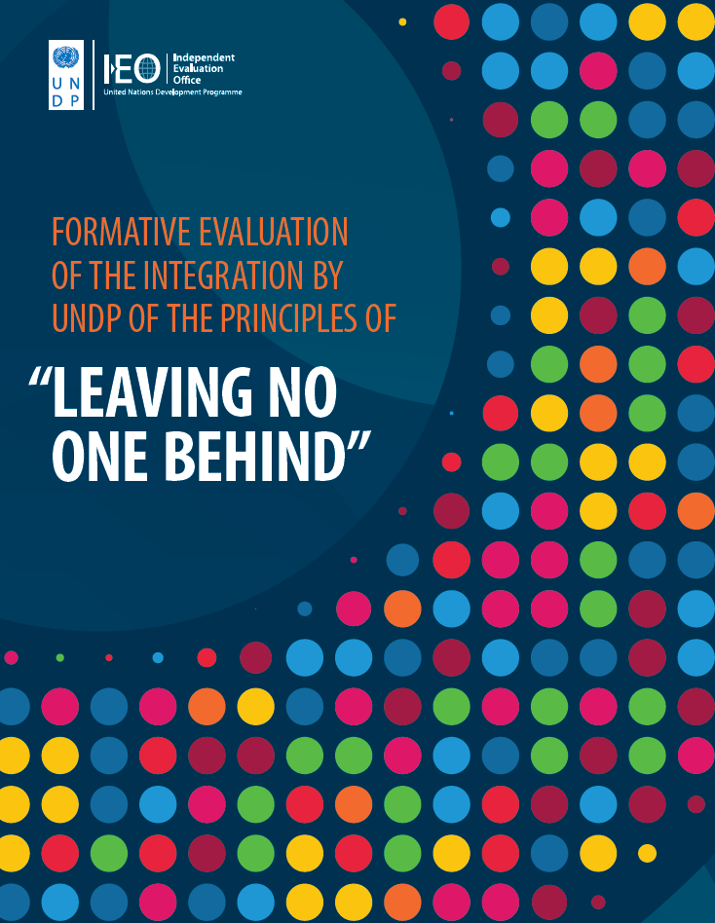



Slide 2
GEF Independent Evaluation Office: review of overall portfolio with IPs (Nov 2017)
  Survey of all participating SGP country programmes
  IEO recognized SGP as the “primary modality of engagement” for IPs with the GEF (GEF/ME/C.53/Inf.07)

Slide 3
Review of SGP engagement with IPs (25 yrs) – completed 2019

Slide 4

Mandate and rationale for GCF to engage Indigenous Peoples
  Paragraph 71 of the Governing Instrument of the Green Climate Fund (GCF):
  “The Board will develop mechanisms to promote the input and participation of stakeholders, including private-sector actors, civil society organizations, vulnerable groups, women and indigenous peoples, in the design, development and implementation of the strategies and activities to be financed by the Fund”

