Slide 1


USING TECHNOLOGY AND ARTIFICIAL INTELIGENCE TO ANALYSE DATA
Niels Jørgen Kjær

Slide 2





Text-classify algorithm
TextClassify is born from 100.000+ UPR recommendations and 169 specific SDG targets
The algorithm is unique for:
  Speed
  2) High degree of transparency: model and results fully explainable
    3) Trained for SDGs and human rights contents
few nanoseconds
TextClassify is able to classify large amounts of text according to the:
  Sustainable Development Goals targets
  Human Rights categories
  Rights-holder groups
English
Spanish

Slide 3



TEXT-CLASSIFY ALGORITHM
A few keywords dominate the meaning, is described by a maximum of 3 components:
  IndigenousPeople
  LandRights
  Biodiversity
TextClassify takes input from a training set where human experts have decided whether texts should be linked to the given category (TRUE) or not (FALSE).

Slide 4





The algorithm in action
OECD-DAC and IATI data from years 2011 and 2021 in the biodiversity, land rights, forestry sector.
Project description:
[…] The activity will work with national and regional authorities and the private sector to build the capacity of civil society, indigenous communities, and local government to improve natural resource management and conservation. The activity will develop economic incentives for biodiversity conservation, such as, commercial agreements, premium prices for products, carbon credits, nature tourism, and production costs reduction. Natural Wealth will support the government in the expansion and creation of national protected areas as well as private reserves. The activity will continue to strengthen land use management, early warning on ecosystem deterioration, and community monitoring.
SDG targets: 1.4, 2.3, 11.4, 12.2, 12.6
Human rights category: Land & Property rights
Rights-holder group: Indigenous Peoples

Slide 5
Project description:
The activity will work with national and regional authorities and the private sector to build the capacity of civil society, indigenous communities, and local government to improve natural resource management and conservation. The activity will develop economic incentives for biodiversity conservation, such as, commercial agreements, premium prices for products, carbon credits, nature tourism, and production costs reduction. Natural Wealth will support the government in the expansion and creation of national protected areas as well as private reserves. The activity will continue to strengthen land use management, early warning on ecosystem deterioration, and community monitoring.
Purity ‘Land & Property rights’ category
→ 85%
→ 85%
→ 100%
→ 0%
The | Activity |  | Work | With | National | And | Regional | Authorities | And
The | Private | Sector | To | Building | The | Capacity | Of | Civil | Society
Indigenous | Community | And | Local | Government | To | Improve | Natural | Resource | Management
And | Conservation | The | Activity |  | Development | Economic | Incardinate | For | Biodiversity
Conservation | Such | As | Commercial | Agreement | Premium | Price | For | Production | Carbon
Credit | Nature | Tourism | And | Production | Cost | Reduce | Natural | Wealth
Support | The | Government |  | The | Expansion | And | Creation | Of | National
Protection | Area | As | Well | As | Private | Reserve | The | Activity
Continue | To | Strengthen | Land | Use | Management | Early | Warn | On
Deterioration | And | Community | Monitor
The | activity | will | work | with | national | and | regional | authorities | and
the | private | sector | to | build | the | capacity | of | civil | society
indigenous | communities | and | local | government | to | improve | natural | resource | management
and | conservation | The | activity | will | develop | economic | incentives | for | biodiversity
conservation | such | as | commercial | agreements | premium | prices | for | products | carbon
credits | nature | tourism | and | production | costs | reduction | Natural | Wealth | will
support | the | government | in | the | expansion | and | creation | of | national
protected | areas | as | well | as | private | reserves | The | activity | will
continue | to | strengthen | land | use | management | early | warning | on | ecosystem
deterioration | and | community | monitoring
Level of importance of the word:
1 2 3
1 2 3

Slide 6
Project description:
The activity will work with national and regional authorities and the private sector to build the capacity of civil society, indigenous communities, and local government to improve natural resource management and conservation. The activity will develop economic incentives for biodiversity conservation, such as, commercial agreements, premium prices for products, carbon credits, nature tourism, and production costs reduction. Natural Wealth will support the government in the expansion and creation of national protected areas as well as private reserves. The activity will continue to strengthen land use management, early warning on ecosystem deterioration, and community monitoring.
Purity ‘Indigenous Peoples’ category
→ 100%
→ 0%
The | Activity |  | Work | With | National | And | Regional | Authorities | And
The | Private | Sector | To | Building | The | Capacity | Of | Civil | Society
Indigenous | Community | And | Local | Government | To | Improve | Natural | Resource | Management
And | Conservation | The | Activity |  | Development | Economic | Incardinate | For | Biodiversity
Conservation | Such | As | Commercial | Agreement | Premium | Price | For | Production | Carbon
Credit | Nature | Tourism | And | Production | Cost | Reduce | Natural | Wealth
Support | The | Government |  | The | Expansion | And | Creation | Of | National
Protection | Area | As | Well | As | Private | Reserve | The | Activity
Continue | To | Strengthen | Land | Use | Management | Early | Warn | On
Deterioration | And | Community | Monitor
Level of importance of the word:
1 2 3

Slide 7
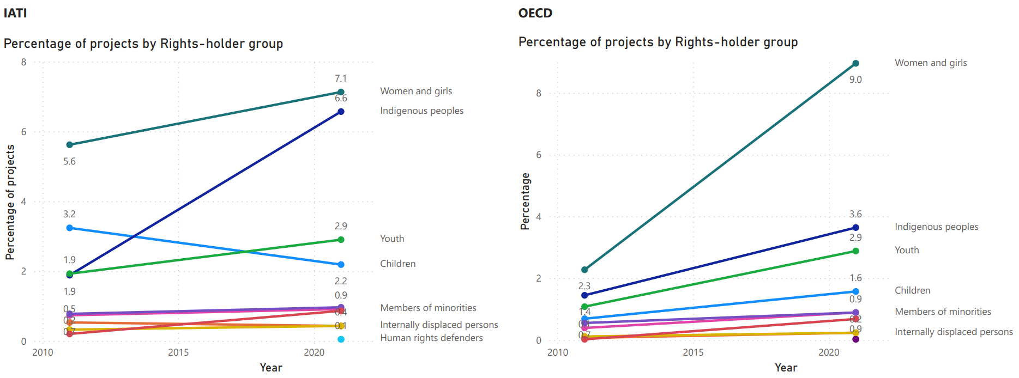
Algorithmic Insights:
Rising Trend in Indigenous peoples-Tagged Projects

Slide 8
moving forward
Analysed the descriptions of the projects → technical quality is good and improving
It is doable to categorize the text with respect to Indigenous Peoples, Land Rights, etc.
Tagging indigenous peoples require a specific input list, since these often are described in projects by their specific name and not by a generic word (e.g., Inuit).
Tagging Land rights already works reasonably well based on the category: ‘Land & property rights’, but it could become even more specific.
Languages: blend of languages in the database is a minor issue as long as the texts contain the meaning in either English or Spanish.

Slide 9
moving forward
Everything is available as open source and runs as a simple script on your PC → the algorithm can be shared and used by other institutions (e.g., OHCHR)
TextClassify not only does all the tedious optimization, it also is capable of answering exactly why!
However, this does mean that the available information is huge and not currently easy to use for a data novice. We are working on a self-explanatory version
"TextClassifyPigeon" where the user can click on previous eLearning examples.
This could result in a large community where many groups can work on any categories and any texts.

Slide 10
Thank you

Slide 11
Additional slides

Slide 12
The algorithm in action
OECD-DAC and IATI data from years 2011 and 2021 in the biodiversity, land rights, forestry sector.
Project description:
The objective of teh project is to realise comprehensive land reforms with the following key outputs: effective and vibrant network of NSA in the land sector; finalisation and implementation of Kenya's National land Policy; Constittional revioew incorporating principles of equity in access to land, property rights and democratic governance of Natural Resources.
SDG targets: 1.4 and 2.3
Human rights category: Land & Property rights

Slide 13
Project description:
The objective of teh project is to realise comprehensive land reforms with the following key outputs: effective and vibrant network of NSA in the land sector; finalisation and implementation of Kenya's National land Policy; Constittional revioew incorporating principles of equity in access to land, property rights and democratic governance of Natural Resources.
Purity: 100%
→ 0%
→ 85%
→ 85%
The | objective | of | teh | project | is | to | realise | comprehensive | land
reforms | with | the | following | key | outputs | effective | and | vibrant | network
of | NSA | in | the | land | sector | finalisation | and | implementation | of
Kenya | s | National | land | policy | Constittional | revioew | incorporating | principles | of
equity | in | access | to | land | property | rights | and | democratic | governance
of | natural | resources
Level of importance of the word:
The | Objective | Of |  | Project | Is | To | Reality | Comprehension | Land
Reform | With | The | Follow | Key | Output | Effective | And | Vibrant | Network
Of | NSA | In | The | Land | Sector | Final | And | Implement | Of
Kenya | S | National | Land | Policy |  |  | Incorporate | Principles | Of
Equity |  | Access |  |  | Property | Rights | And | Democratic | Government
Of | Natural | Resource | LandReform | LandRights | NaturalResource
1 2 3
1 2 3

Slide 14
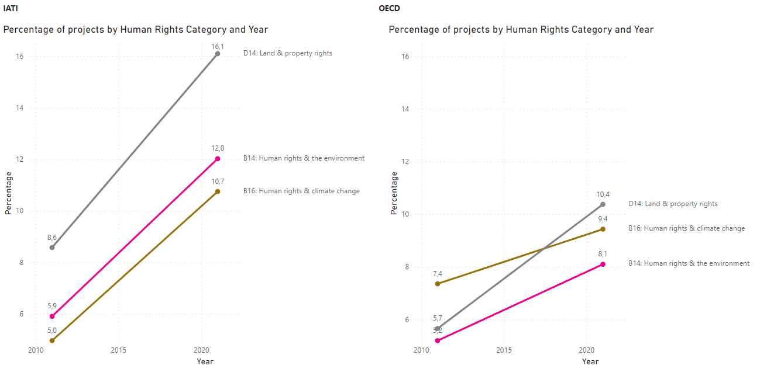
ALGORITHM TAGGING REVEALS:
Upward Trend in projects tagged with relevant human rights categories

